Slide 1
Data Cleaning Using R

Slide 2
Data Cleaning Definition
The process to transform raw data into consistent data that can be easily analyzed.
It is aimed at filtering the content of statistical statements .
To improves your data quality and overall productivity.

Slide 3
Objective of Data Cleaning
The following are the various purposes of data cleaning in R:
Eliminate Errors
Eliminate Redundancy
Increase Data Reliability
Delivery Accuracy
Ensure Consistency
Assure Completeness
Standardize your approach

Slide 4
Clean Data Vs Messy Data
Messy Data
Special characters (e.g. commas in numeric values)
Numeric values stored as text/character data types
Duplicate rows
Misspellings
Inaccuracies
White space
Missing data
Zeros instead of null values vary.
Clean Data
Free of duplicate rows/values
Error-free (misspellings free )
Relevant (special characters free )
The appropriate data type for analysis
Free of outliers (or only contain outliers that have been identified/understood)
Neat and clean data structure

Slide 5
Data Cleaning Example
Using inbuilt datasets(“airquality” datasets)
> head(airquality)
Ozone Solar.R Wind Temp Month Day
1 41 190 7.4 67 5 1
2 36 118 8.0 72 5 2
3 12 149 12.6 74 5 3
4 18 313 11.5 62 5 4
5 NA NA 14.3 56 5 5
6 28 NA 14.9 66 5 6
The NA value inside the columns

Slide 6
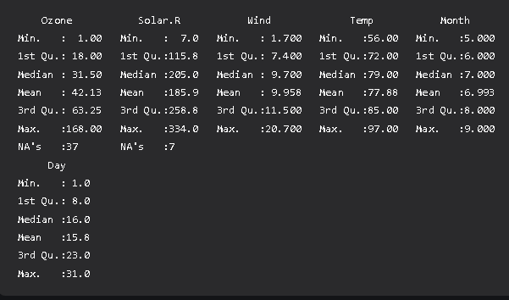
Summary Function
> summary(airquality)

Slide 7
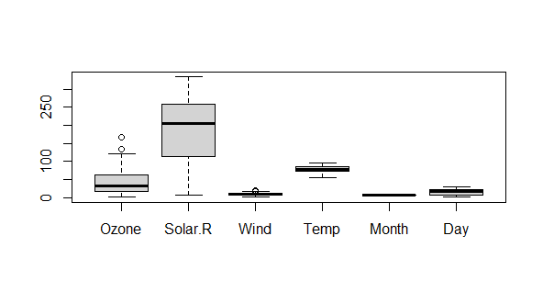
We can get a clear visual of the irregular data using a boxplot.
boxplot(airquality)

Slide 8
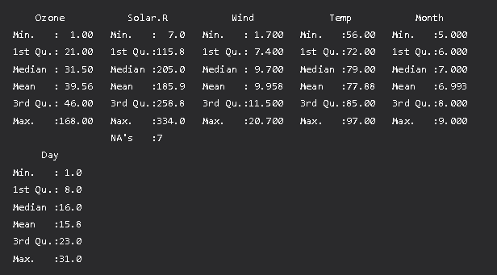
Removing irregularities data with is.na() methods
New_df = airquality
New_df$Ozone = ifelse(is.na(New_df$Ozone), median(New_df$Ozone,
na.rm = TRUE),)

Slide 9
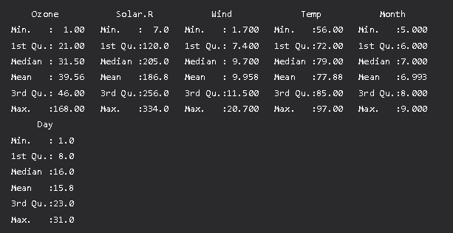
Performing the same operation in another column.
New_df$Solar.R = ifelse(is.na(New_df$Solar.R), median(New_df$Solar.R,
na.rm = TRUE), New_df$Solar.R) )
summary(New_df)

Slide 10
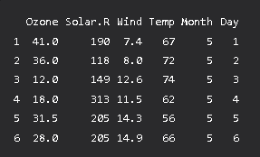
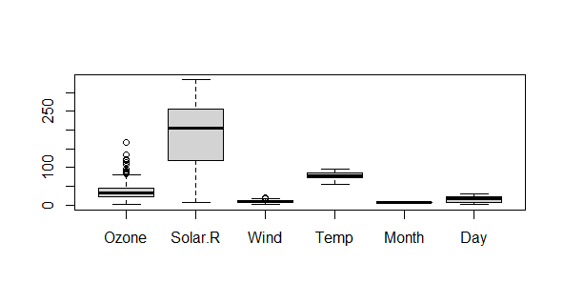
head(New_df)

Slide 11
An Illustration with Example
1) Creation of Example Data
2) Example 1: Modify Column Names
3) Example 2: Format Missing Values
4) Example 3: Remove Empty Rows & Columns
5) Example 4: Remove Rows with Missing Values
6) Example 5: Remove Duplicates
7) Example 6: Modify Classes of Columns
8) Example 7: Detect & Remove Outliers
9) Example 8: Remove Spaces in Character Strings
10) Example 9: Combine Categories

Slide 12
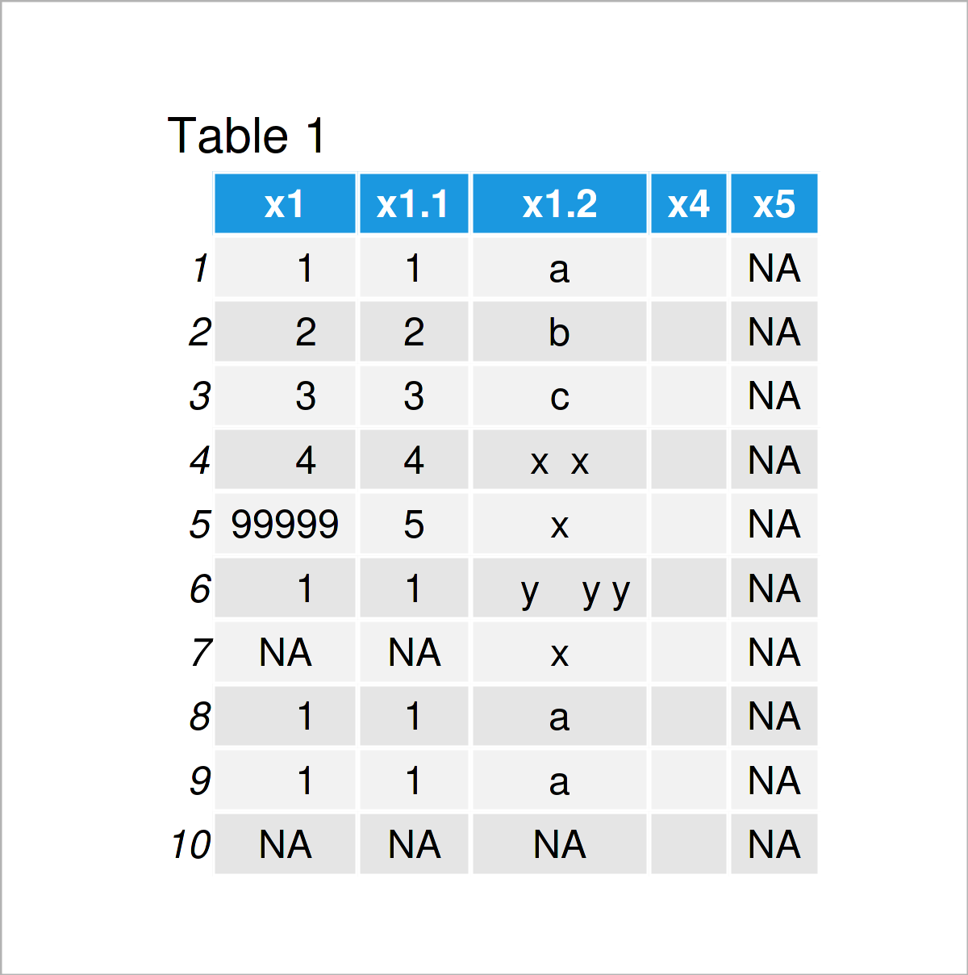
Creation of Example Data
data <- data.frame(x1 = c(1:4, 99999, 1, NA, 1, 1, NA), # Create example data frame
x1 = c(1:5, 1, "NA", 1, 1, "NA"),
x1 = c(letters[c(1:3)], "x x", "x", " y y y", "x", "a", "a", NA),
x4 = "",
x5 = NA)
data

Slide 13
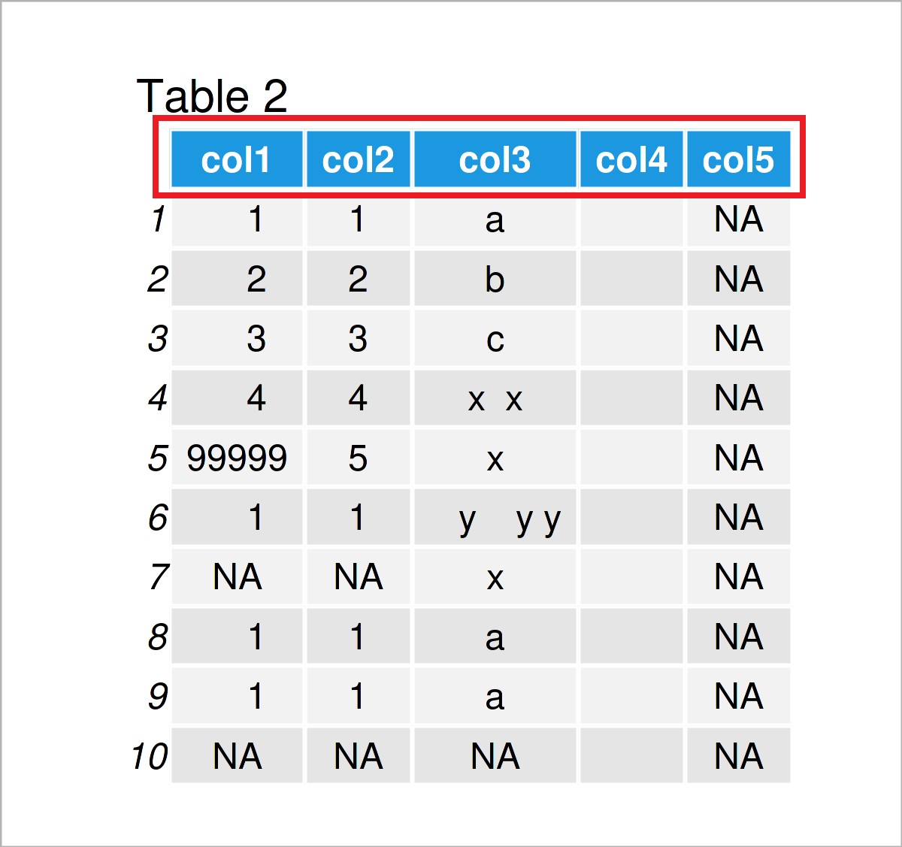
Example 1: Modify Column Names
Let’s first have a closer look at the names of our data frame columns:
colnames(data)
# Print column names# [1] "x1" "x1.1" "x1.2" "x4" "x5“
Let’s assume that we want to change these column names to a consecutive range with the prefix “col”. Then, we can apply the colnames, paste0, and ncol functions as shown below.
#Modify all column namesdata
colnames(data) <- paste0("col", 1:ncol(data))
# Print updated data frame

Slide 14
Example 2: Format Missing Values
In the R programming language, missing values are usually represented by NA. For that reason, it is useful to convert all missing values to this NA format.
Some missing values are represented by blank character strings.
data[data == ""] # Print blank data cells# [1] NA NA NA "" "" "" "" "" "" "" "" "" "" NA NA NA NA NA NA NA NA NA NA
Assign NA values to those blank cells, we can use the following syntax:
data[data == ""] <- NA # Replace blanks by NA
have a closer look at the column col2:
data$col2 # Print column# [1] "1" "2" "3" "4" "5" "1" "NA" "1" "1" "NA"

Slide 15
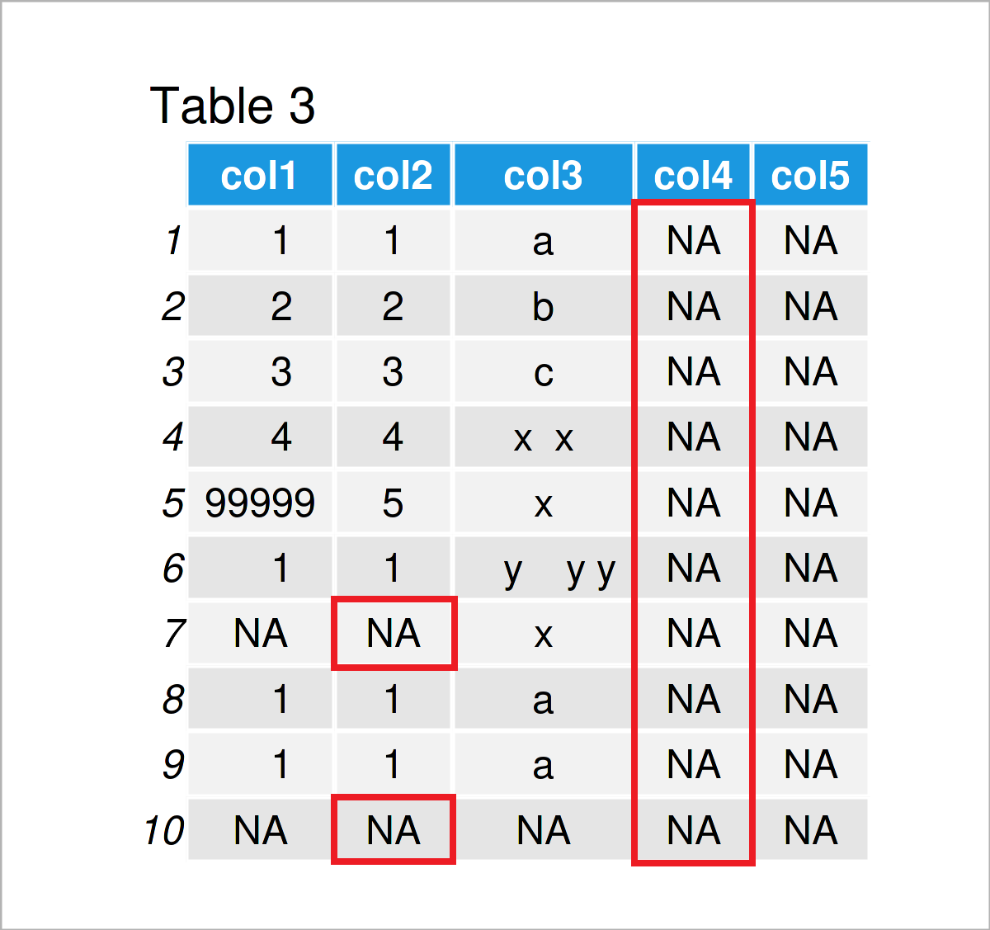
Example 2: Format Missing Values
The NA values in this column are shown between quotes (i.e. “NA”). This indicates that those NA values are formatted as characters instead of real NA values.
We can change that using the following R code:
data$col2[data$col2 == "NA"] <- NA # Replace character "NA"
data # Print

Slide 16
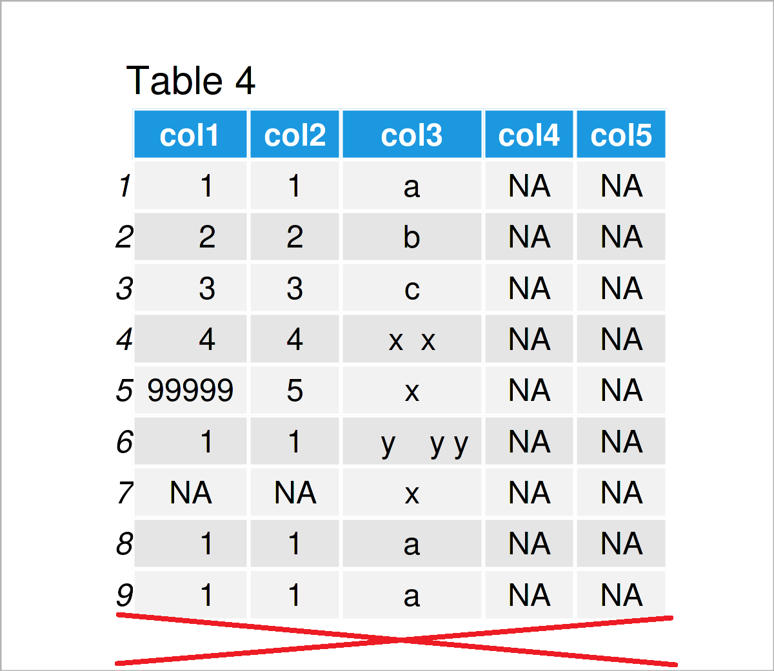
Example 3: Remove Empty Rows & Columns
Use the rowSums, is.na, and ncol functions to remove only-NA rows:
data <- data[rowSums(is.na(data)) != ncol(data), ] # Drop empty rowsdata # Print updated data frame

Slide 17
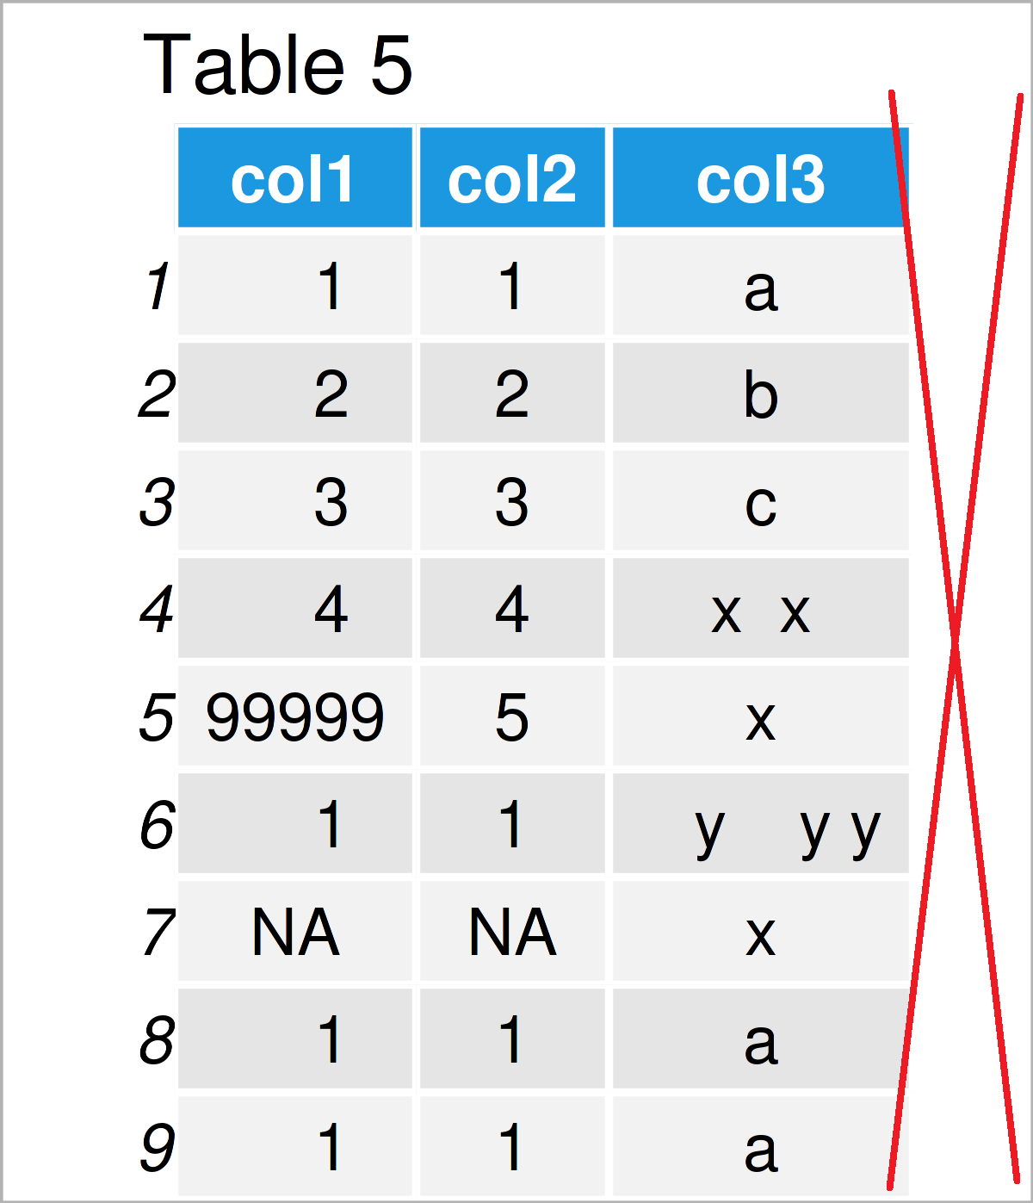
Example 3: Remove Empty Rows & Columns
Also exclude columns that contain only NA values
data <- data[ , colSums(is.na(data)) != nrow(data)] # Drop empty columnsdata # Print updated data frame

Slide 18
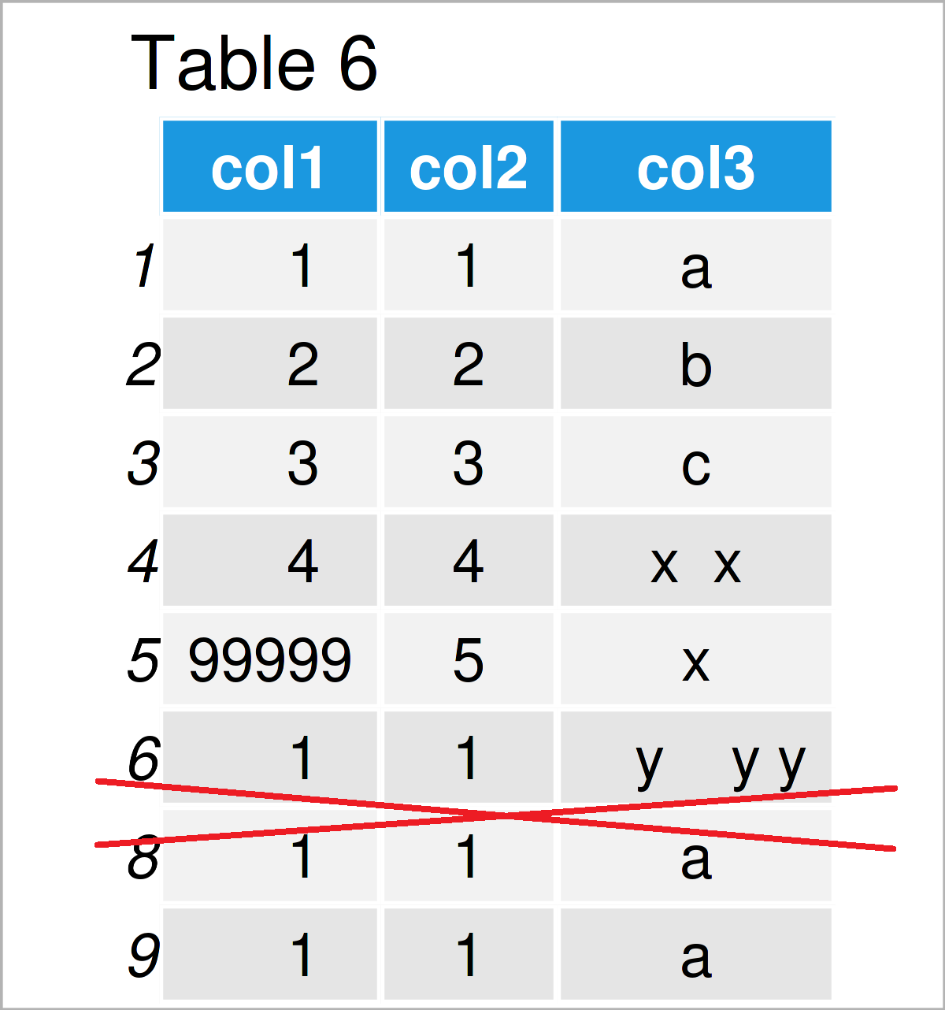
Example 4: Remove Rows with Missing Values
in case you have decided to remove all rows with one or more NA values, you may use the na.omit function as shown below:
data <- na.omit(data) # Delete rows with missing values data # Print updated data frame

Slide 19
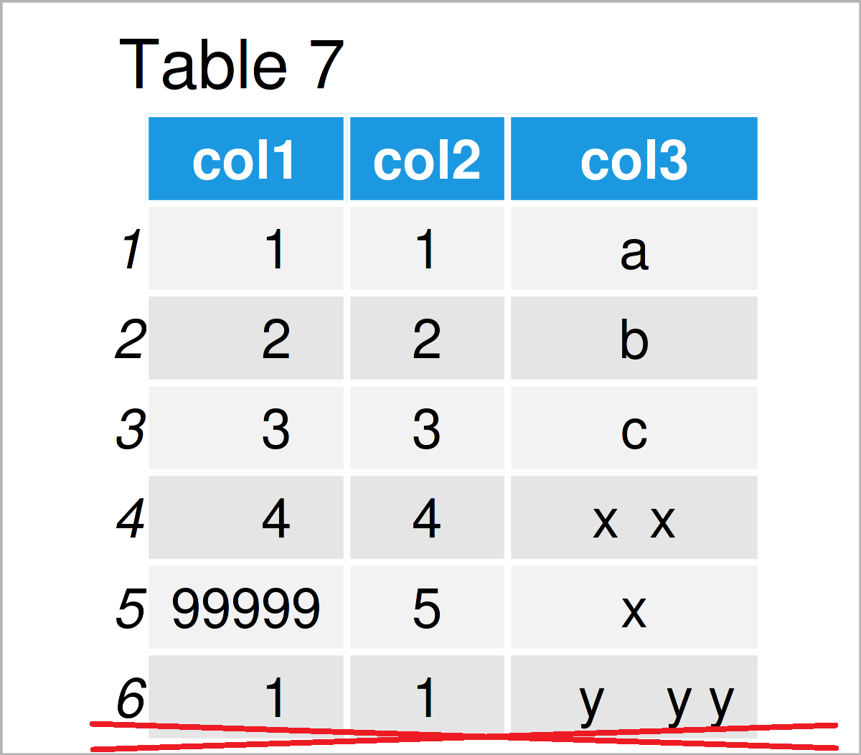
Example 5: Remove Duplicates
Use the unique function to our data frame as demonstrated in the following R snippet:
data <- unique(data) # Exclude duplicates data # Print updated data frame

Slide 20
Example 6: Modify Classes of Columns
The class of the columns of a data frame is another critical topic when it comes to data cleaning.
This example explains how to format each column to the most appropriate data type automatically.
Let’s first check the current classes of our data frame columns:
sapply(data, class) # Print classes of all columns
# col1 col2 col3
# "numeric" "character" "character"
use the type.convert function to change the column classes whenever it is appropriate:
data <- type.convert(data, as.is = TRUE)
data # Print updated data frame

Slide 21
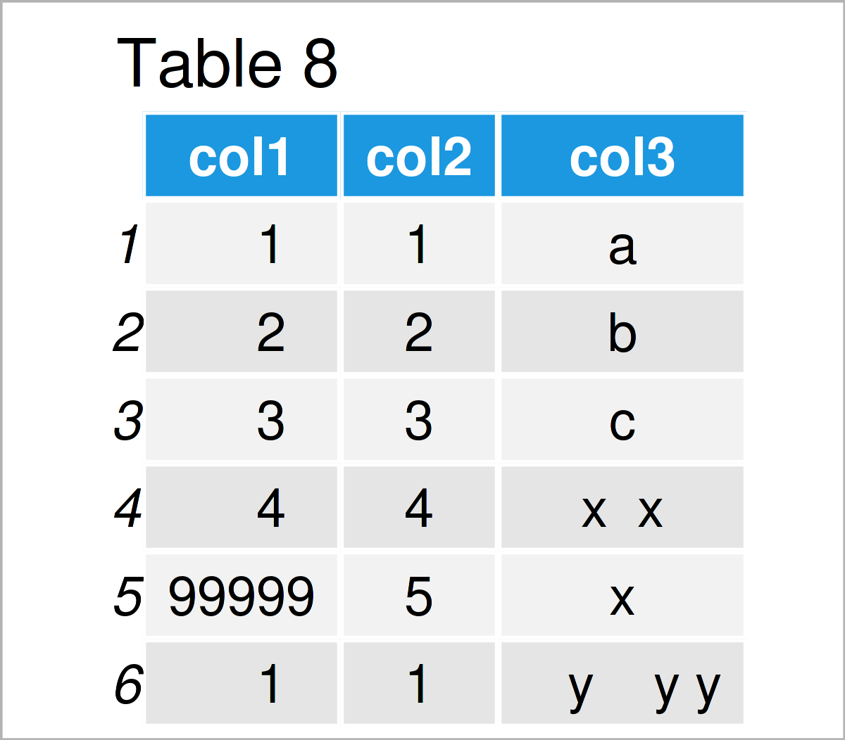
Print the data types of our columns once again, we can see that the first two columns have been changed to the integer class.
sapply(data, class) # Print classes of updated columns
# col1 col2 col3
# "integer" "integer" "character"

Slide 22
Example 7: Detect & Remove Outliers
One method to detect outliers is provided by the boxplot.stats function
# Identify outliers in column# [1] 99999
data$col1[data$col1 %in% boxplot.stats(data$col1)$out]
The previous output has returned one outlier (i.e. the value 99999). This value is obviously much higher than the other values in this column.
Apply the R code below to remove the outlier:
# Remove rows with outliersdata
data <- data[! data$col1 %in% boxplot.stats(data$col1)$out, ]

Slide 23
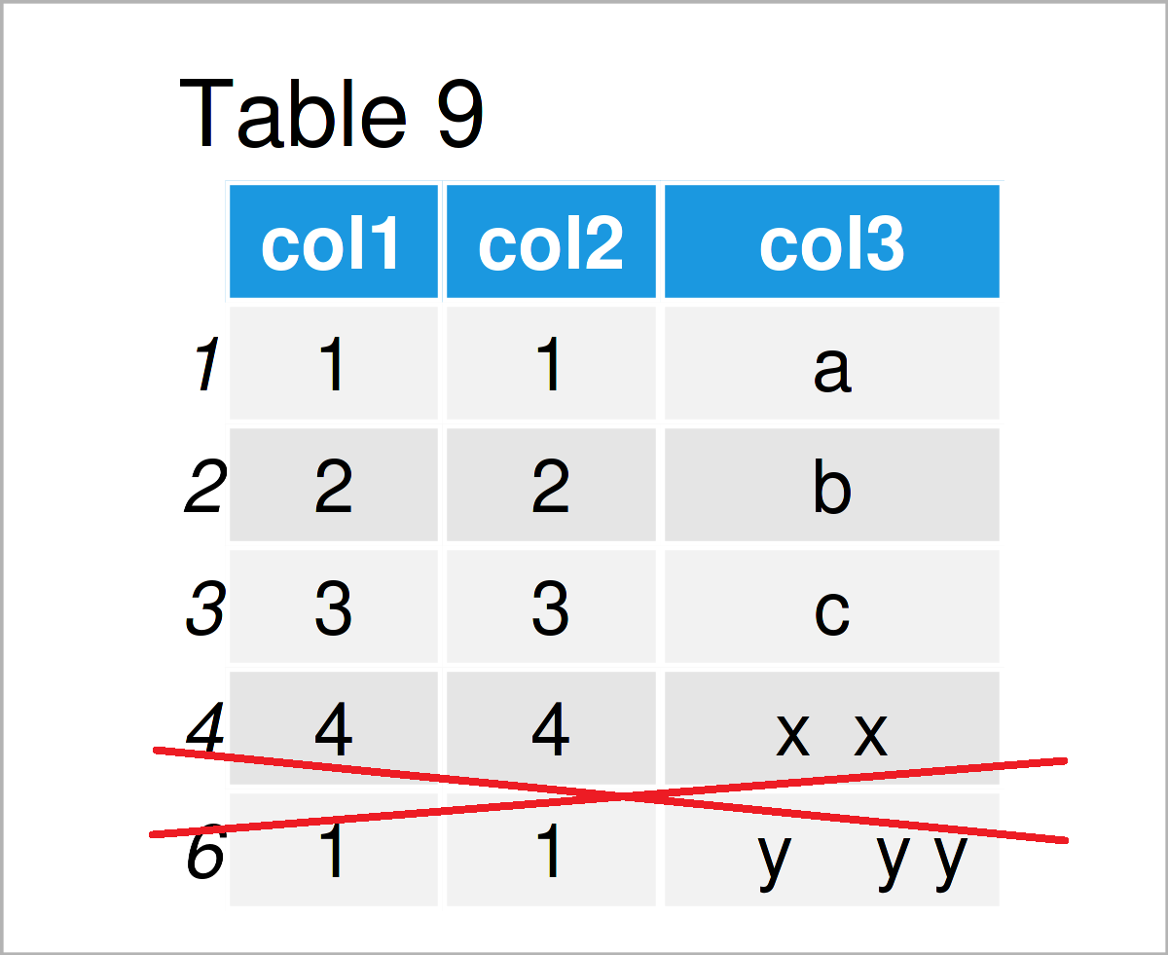

Slide 24
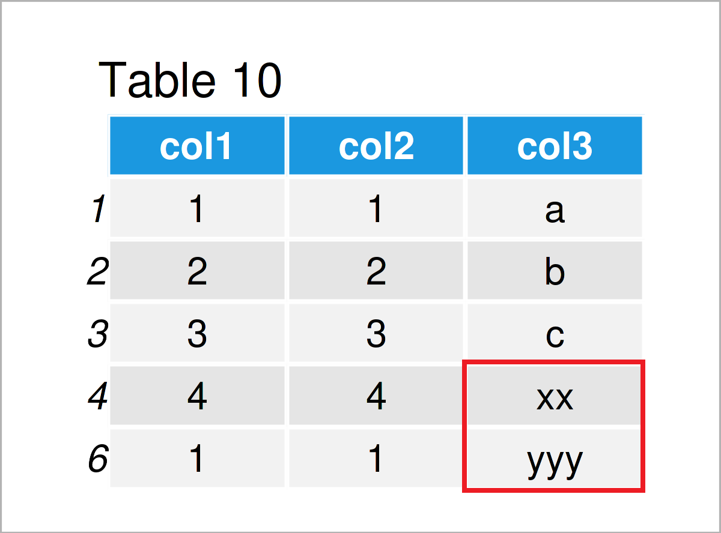
Example 8: Remove Spaces in Character Strings
Use the gsub function as demonstrated below
# Delete white space in character stringsdata
data$col3 <- gsub(" ", "", data$col3)

Slide 25
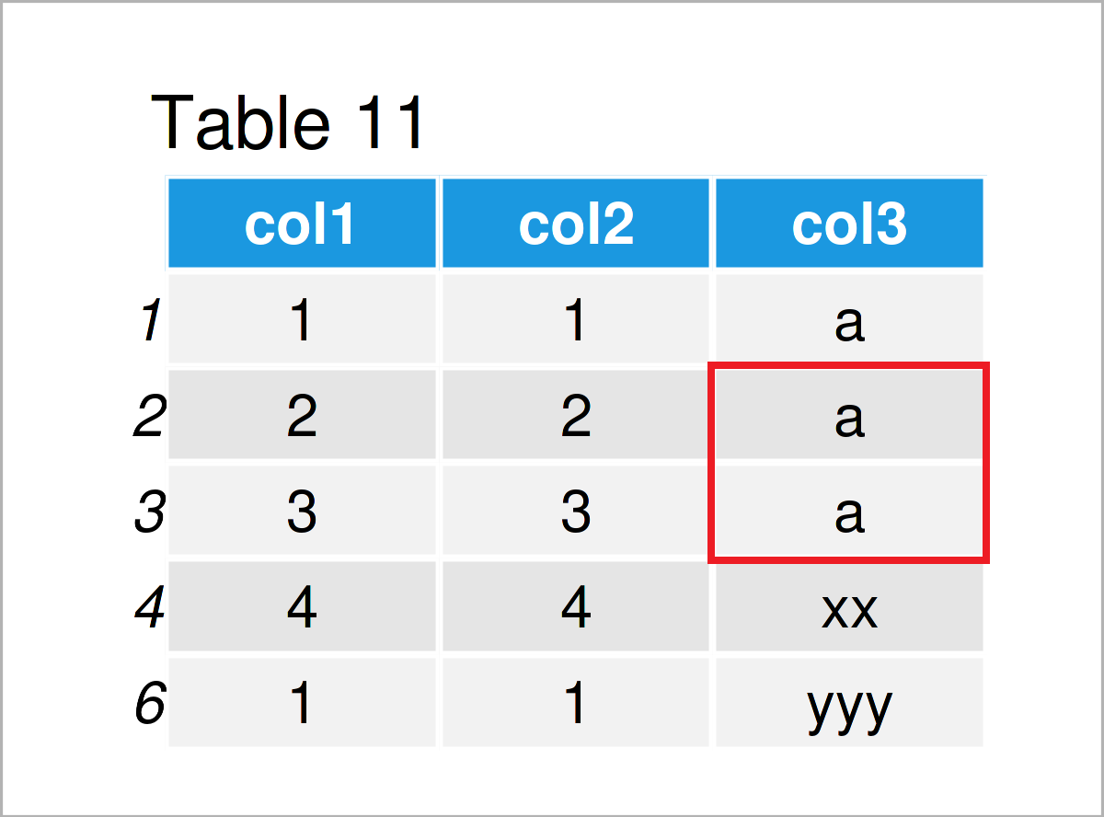
Example 9: Combine Categories
Use the gsub function as demonstrated below
The following R code illustrates how to group the categories “a”, “b”, and “c” in a single category “a”.
data$col3[data$col3 %in% c("b", "c")] <- "a" # Merge categoriesdata # Print updated data frame

Slide 26
Thanks

